Slide 1
Building recognition using Unet
December 7, 2019

Slide 2
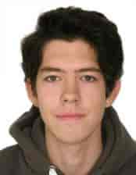
Who am I?
Bachelor’s degree in Applied Mathematics and Informatics
Master’s degree in Data Science
Conducted course on Deep Learning in HSE university. Materials of course: https://www.coursera.org/learn/intro-to-deep-learning
Previously worked in Deloitte Moscow
Work in Deloitte Dubai since July, 2019

Slide 3
Building recognition
Aim of the project:
Detect buildings on satellite images
Match them with internal client Database and find illegal buildings

Slide 4
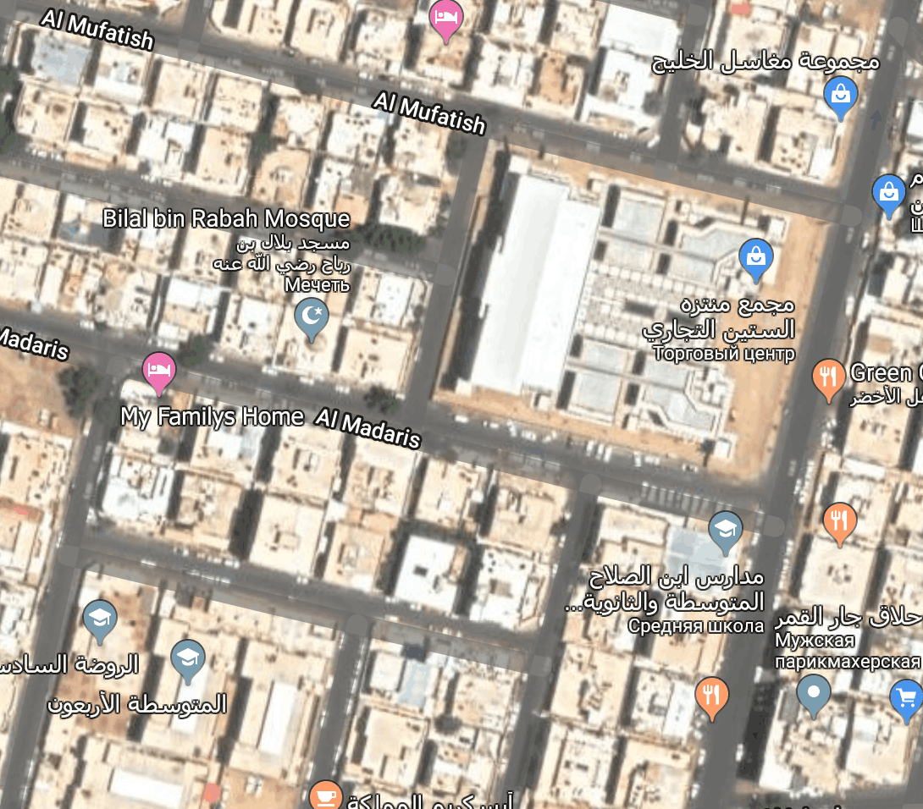
Motivation for recognition:

Slide 5
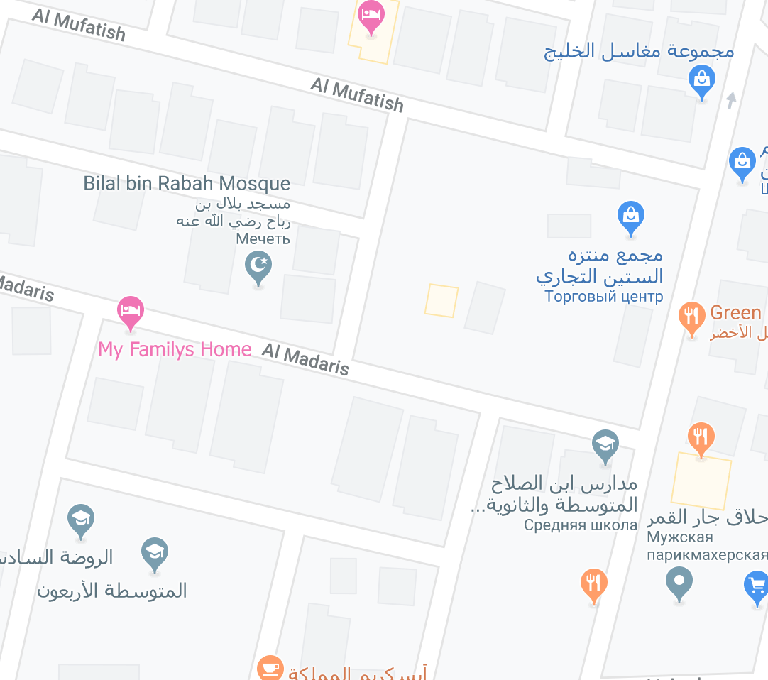
Motivation for recognition:

Slide 6
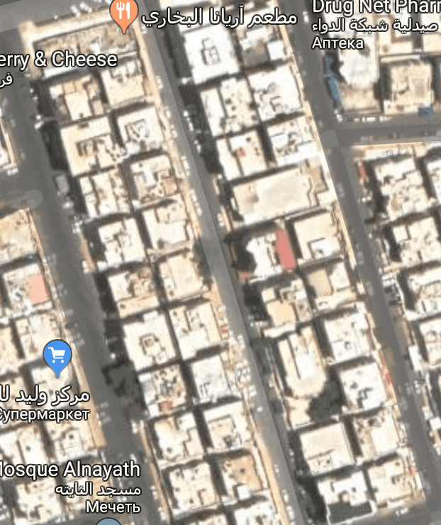
Motivation for recognition:

Slide 7
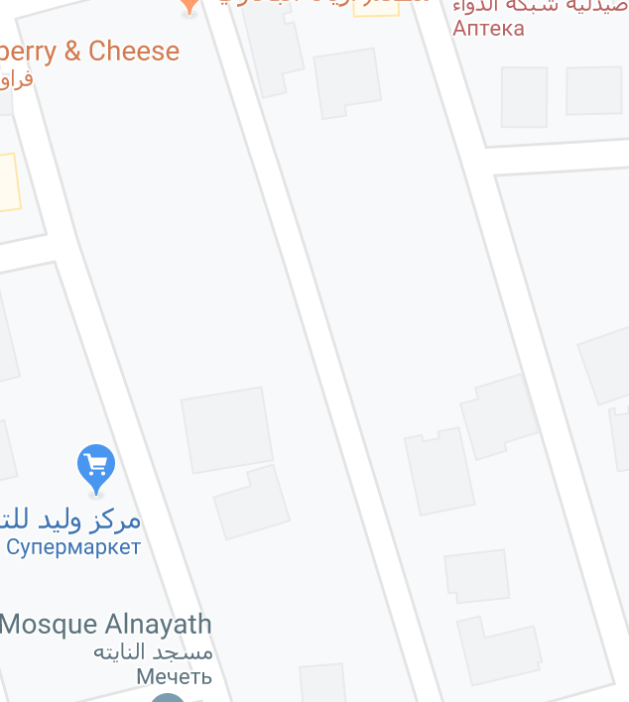
Motivation for recognition:

Slide 8
ML formulation of the problem:

Slide 9
1 step: Gathering Satellite images
Each image has format *.tif
Each image has MetaData inside: coordinates of top left corner + scale (necessary for visualization purposes on maps)
Gdal library in python

Slide 10
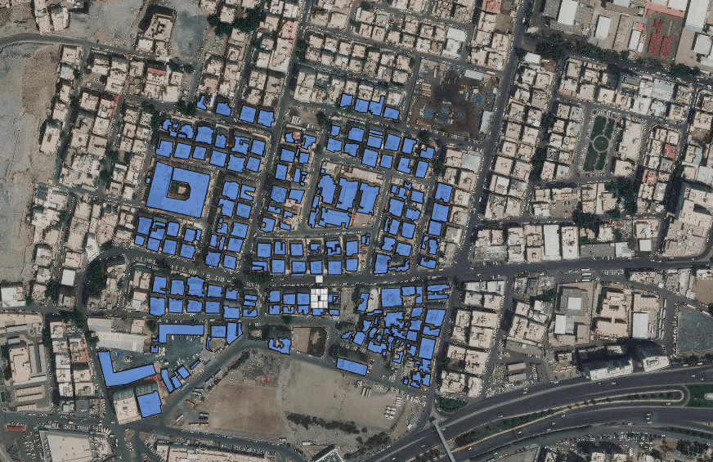
1 step: Manually label data

Slide 11
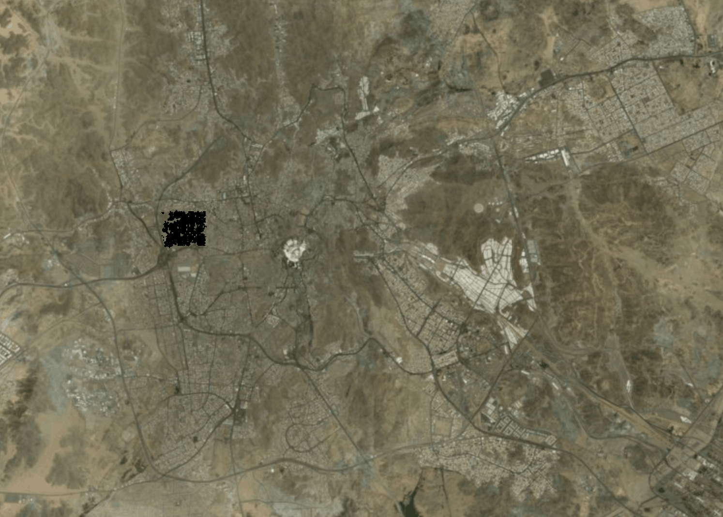
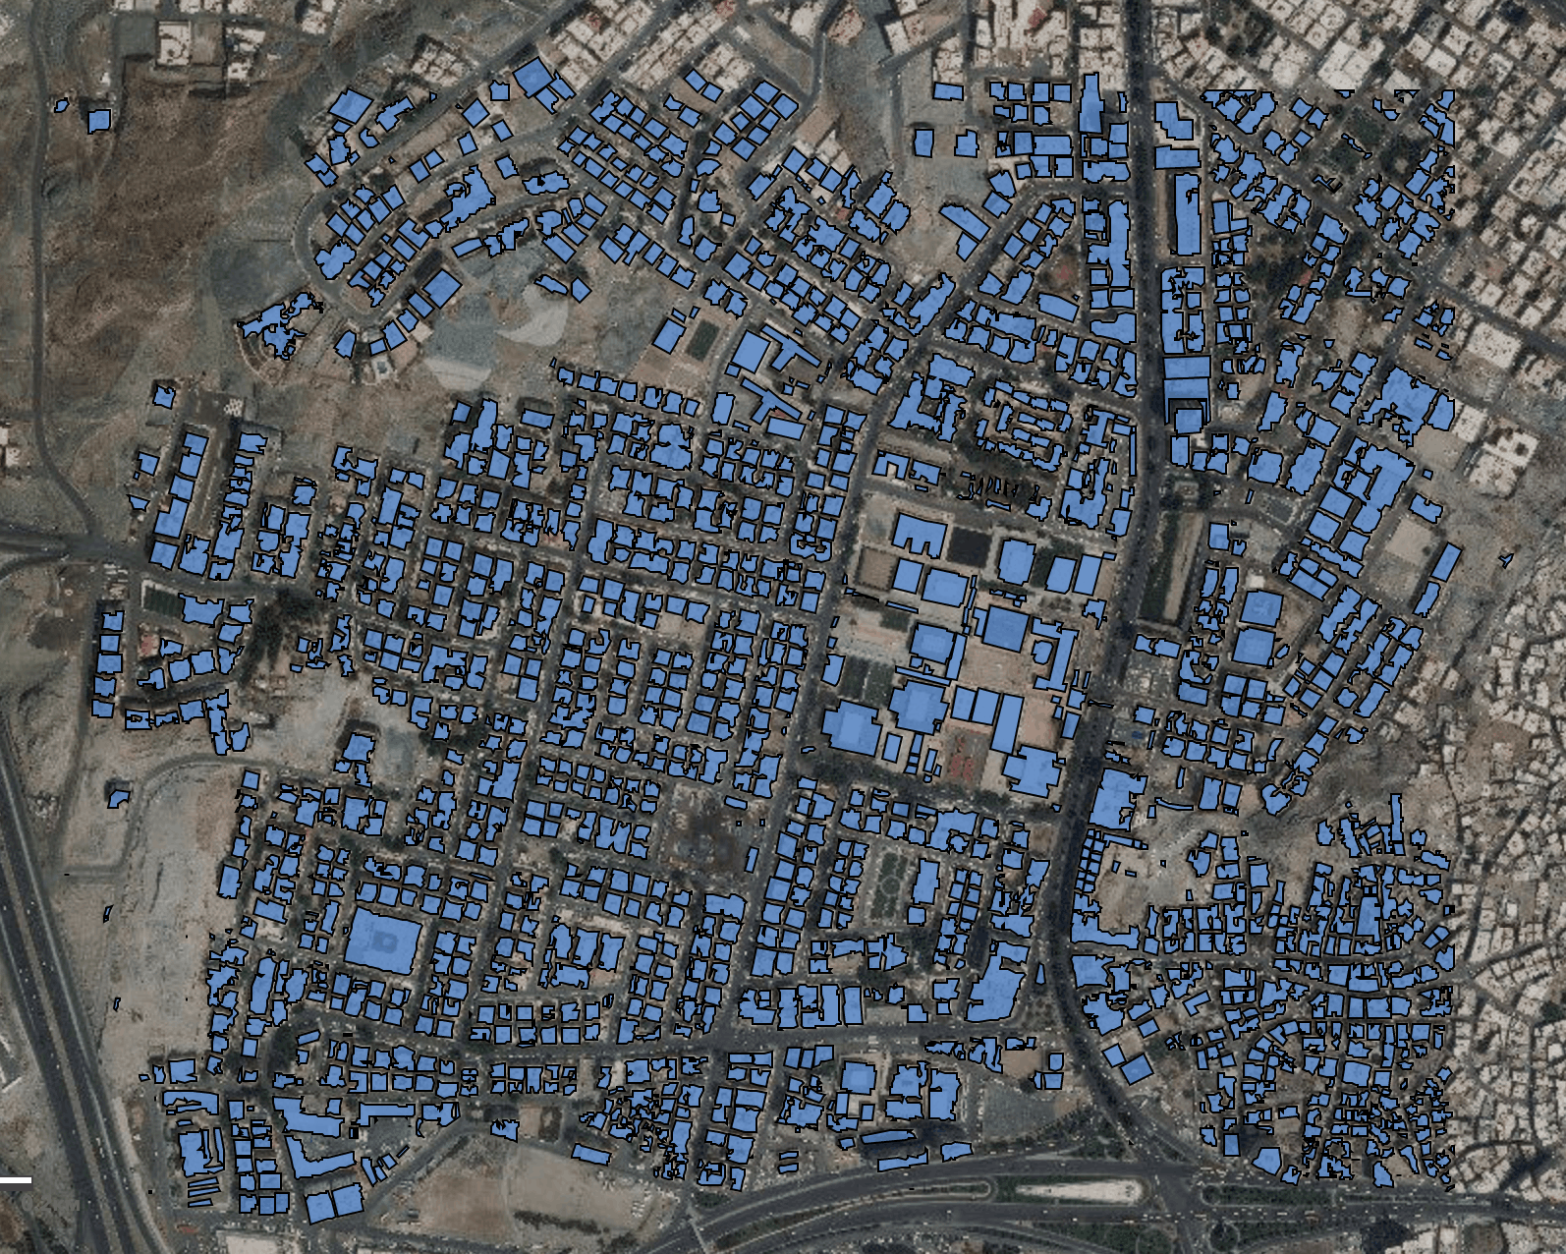
1 step: Manually label data

Slide 12
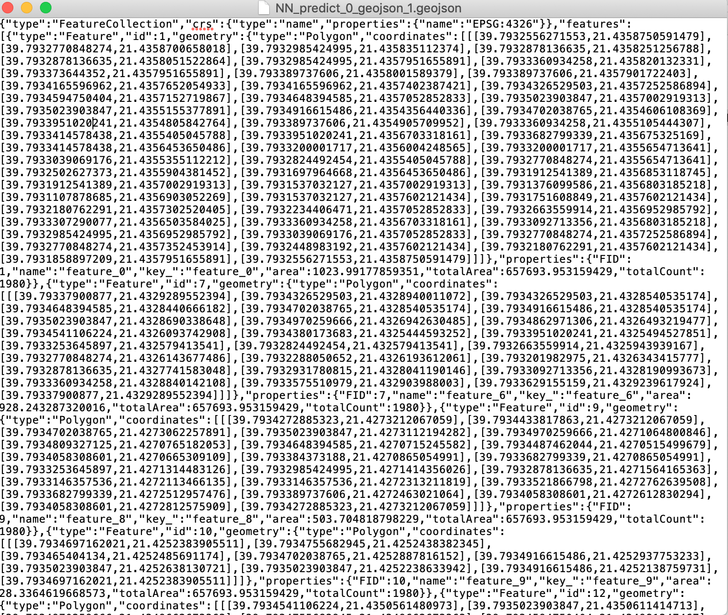
1 step: Manually label data
longitude
latitude
So we got two files:
*.tif images
json with coordinates (~200-300 buildings)

Slide 13
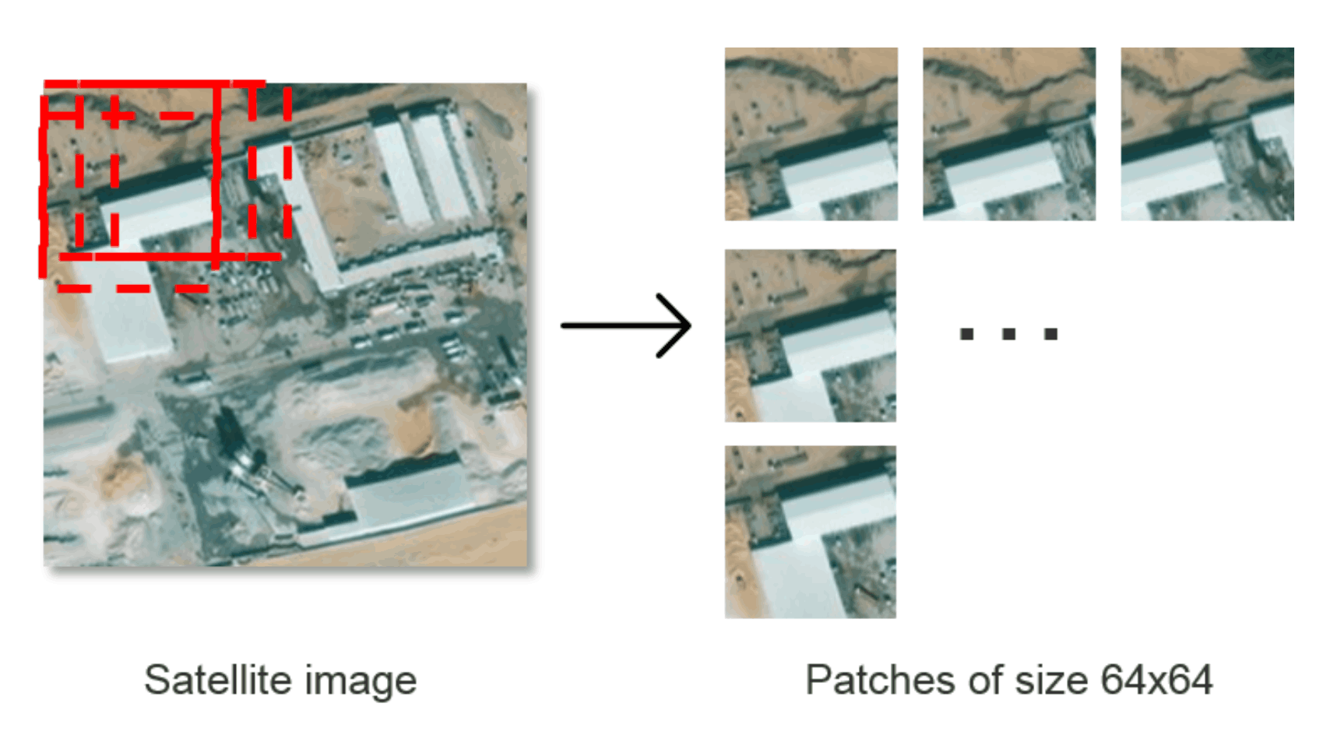
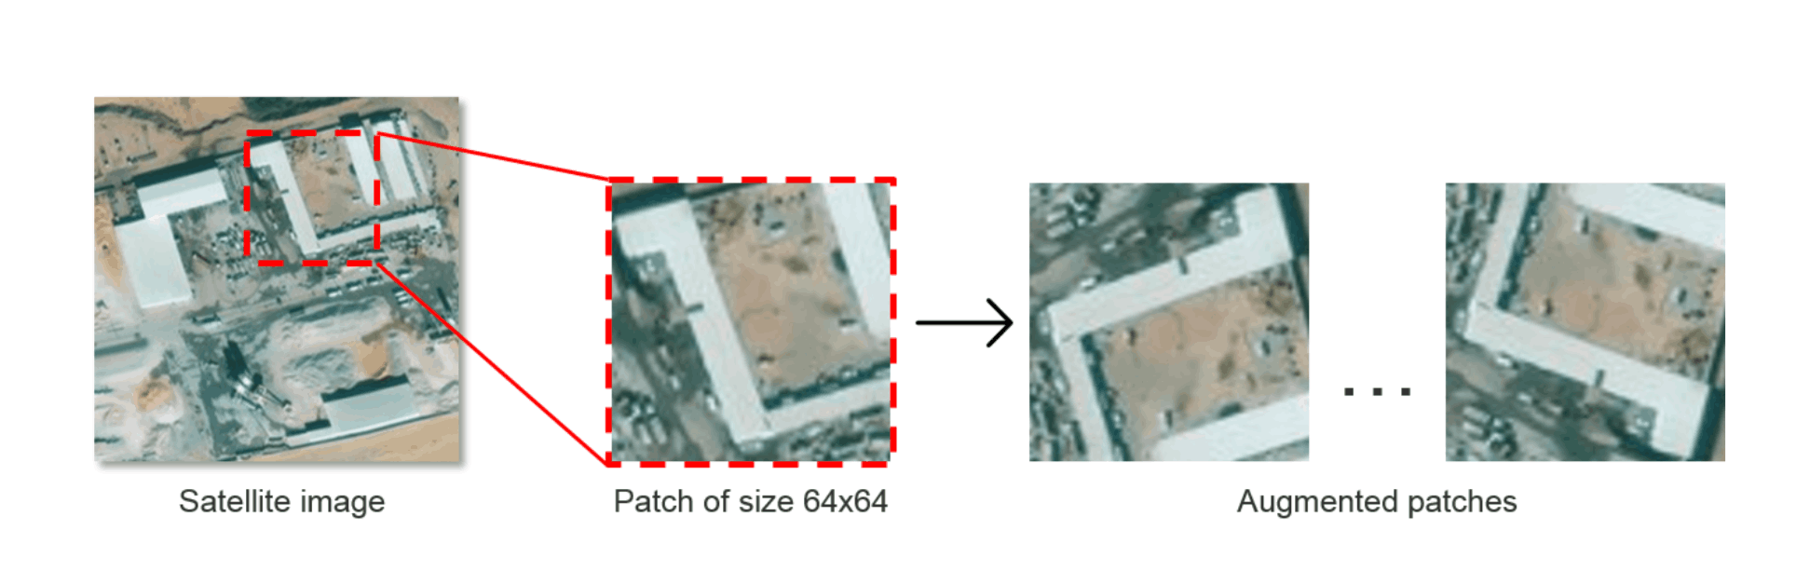
2 step: data preparation for training
For each satellite image create binary mask using json
Each each image from training dataset cut on 128x128 blocks
Data augmentation: rotation of pairs (image, binary mask) by 90, 180 and 270 degrees

Slide 14
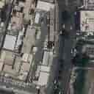
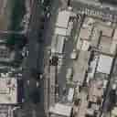
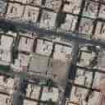
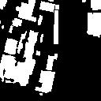
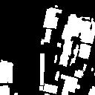
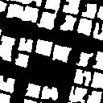
2 step: data preparation for training
+ Json
...
...

Slide 15
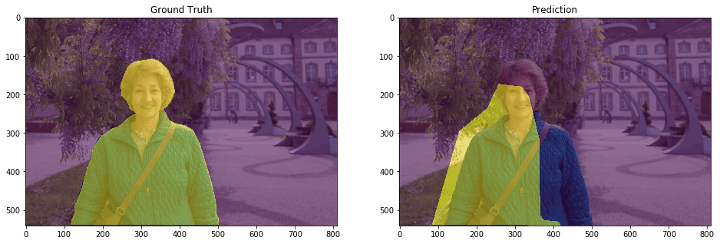
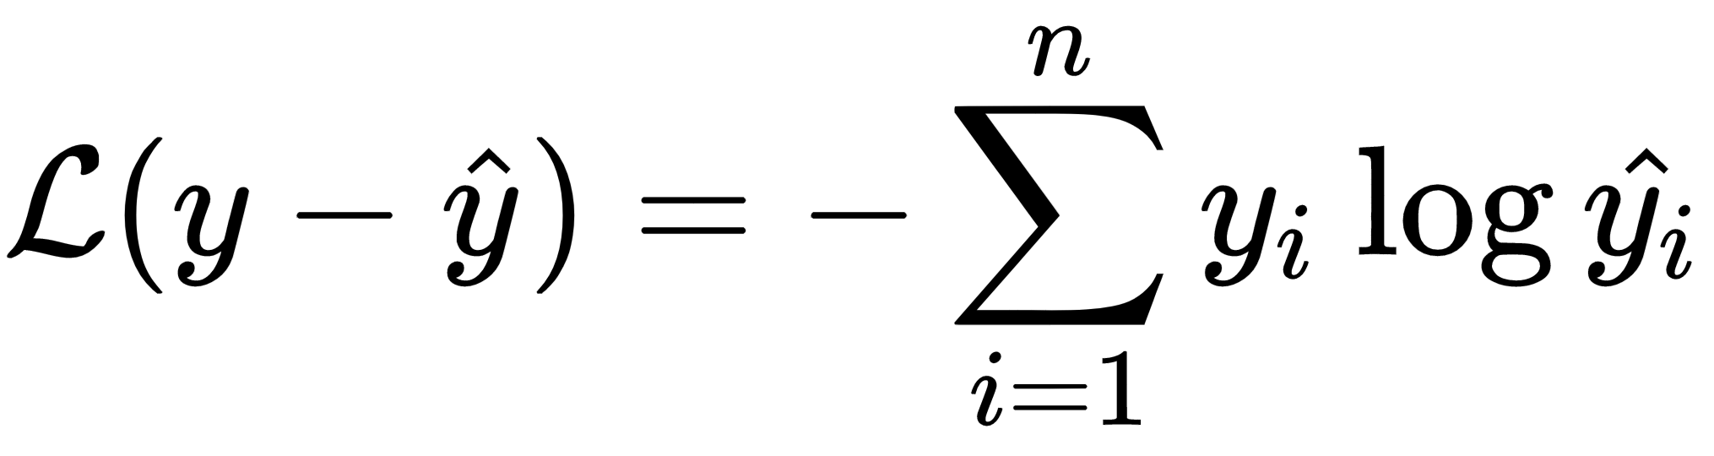
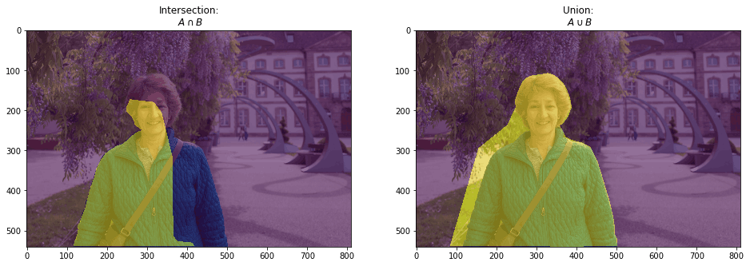
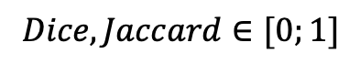
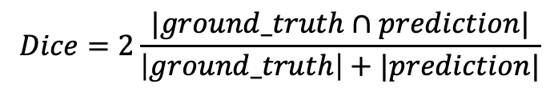
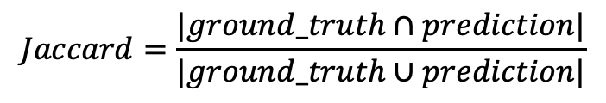
3 step: Metrics
Loss function:
$$Dice=2\frac{|ground_truth∩prediction|}{\left|ground_truth\right|+|prediction|}$$
$$Jaccard=\frac{|ground_truth∩prediction|}{|ground_truth∪prediction|}$$
$$Dice, Jaccard∈[0;1]$$

Slide 16
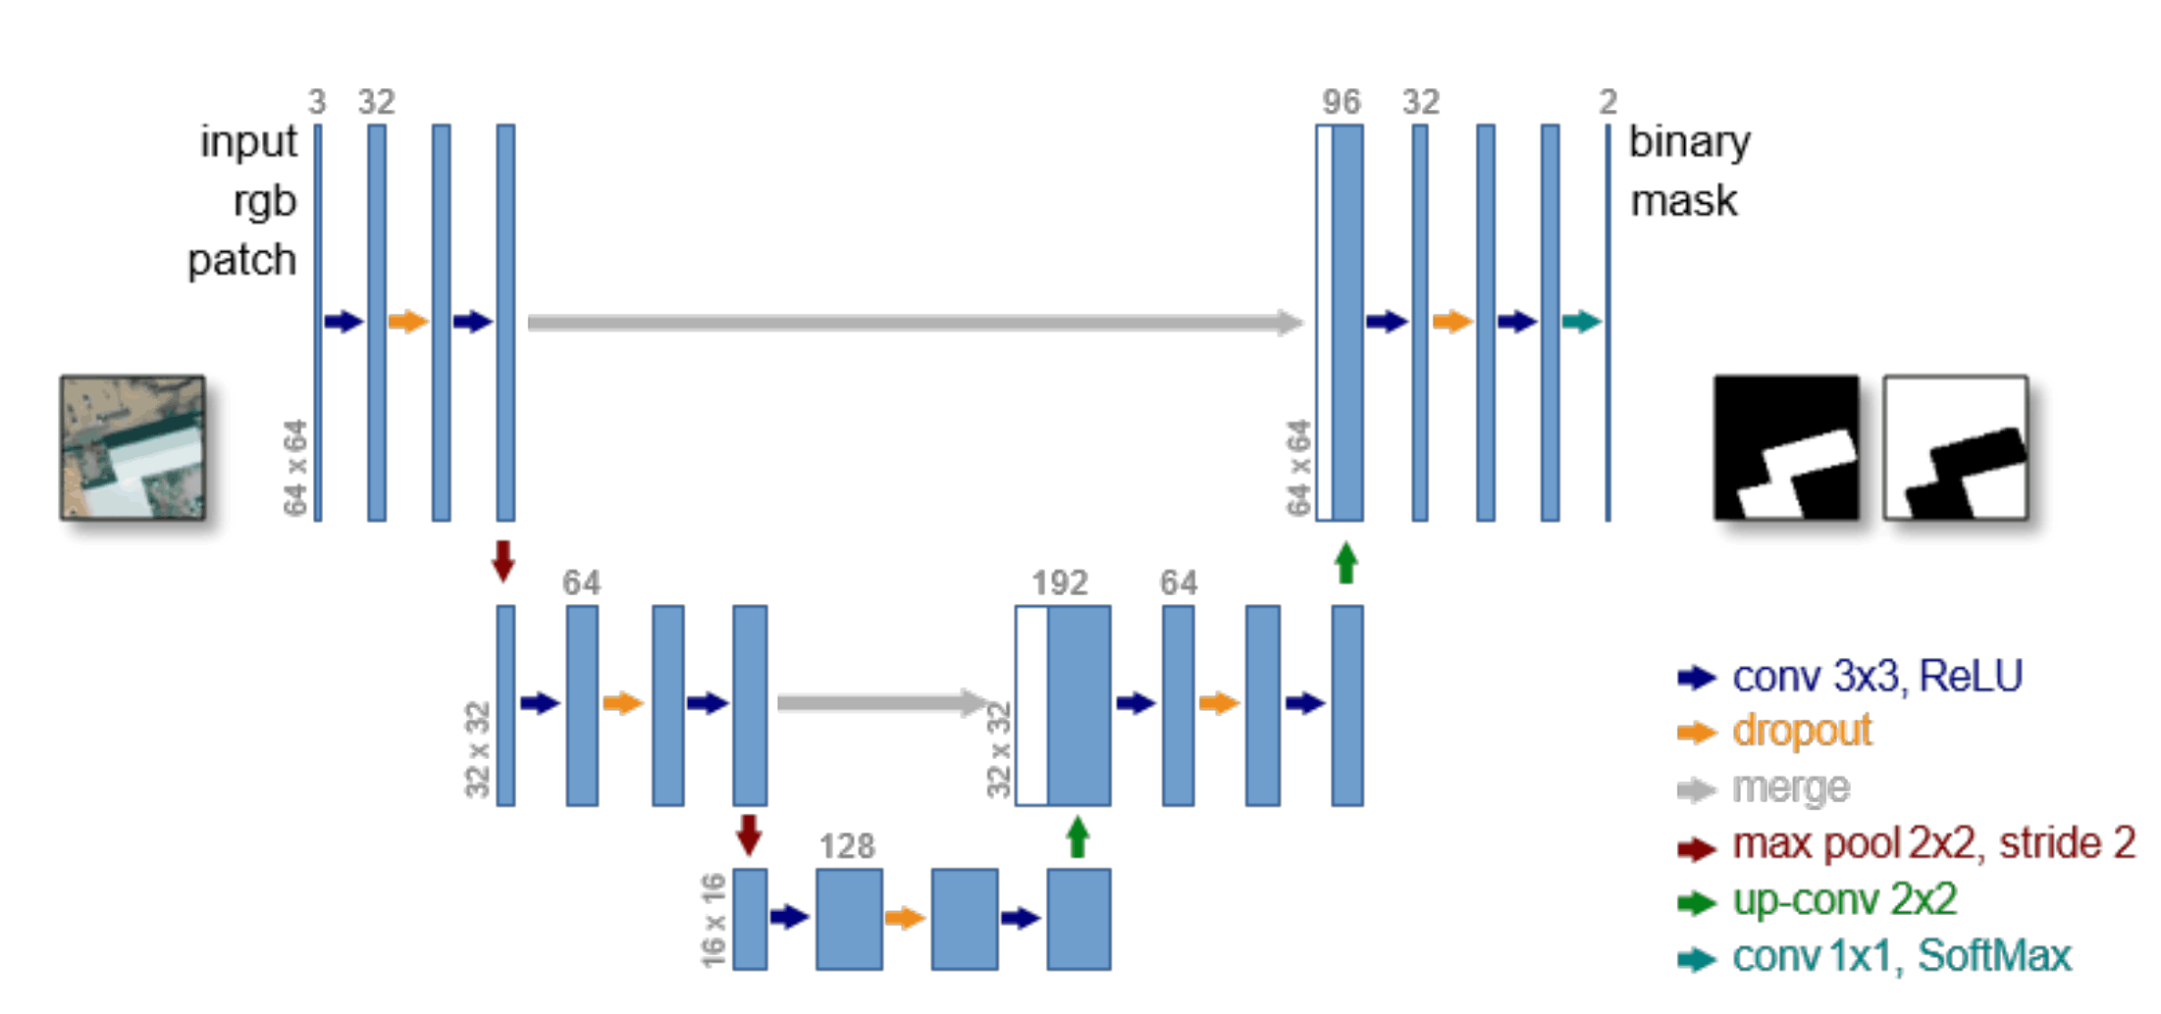
4 step: model & training

Slide 17
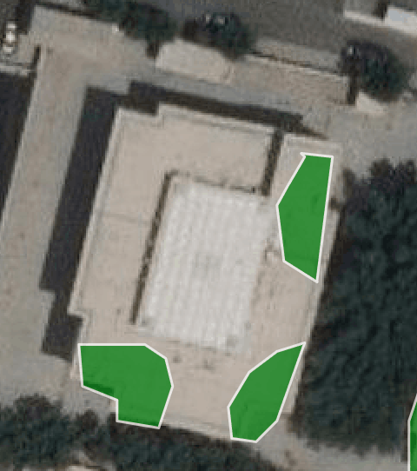
4 step: model & training
Unet model training with weights starting from pretrained weights
Jaccard ~0.885, dice coeff 0.94, f1 score ~ 0.96
3-4 hours of training
One GPU Tesla P1000
Model validation

Slide 20
5 step: Polygons extraction
Output of NN: Probabilistic heatmap
Necessary output of NN: json with coordinates
Solution:
Thresholding of heatmaps
Douglas-Peucker algorithm https://en.wikipedia.org/wiki/Ramer%E2%80%93Douglas%E2%80%93Peucker_algorithm

Slide 21
6 step: Demo
http://35.208.27.233:5555/map

Slide 22
Contacts
dmitryhse@gmail.com
https://ae.linkedin.com/in/dmitry-denisov-022102103

